Slide 1
Forecast Gold Prices Batch-7
Project mentor - Mr.Vinod

Slide 2
Business Objective:
Data is about gold price. The main objective is to understand the underlying structure in the dataset and come up with a suitable forecasting model which can effectively forecast gold prices for next 30 days.

Slide 3
Business problem:
This forecast model will be used by gold exporting and gold importing companies to understand the metal price movements and accordingly set their revenue expectations.

Slide 4
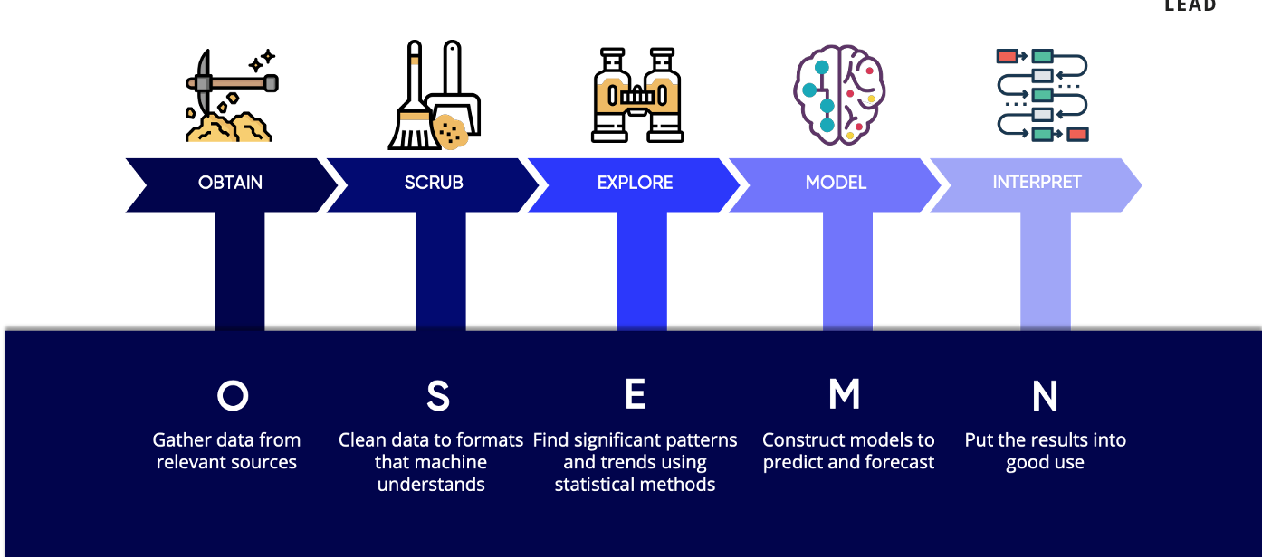
Project Workflow

Slide 5
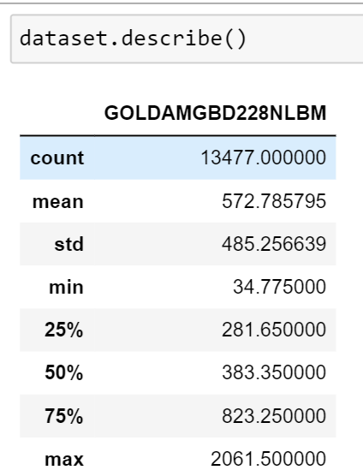
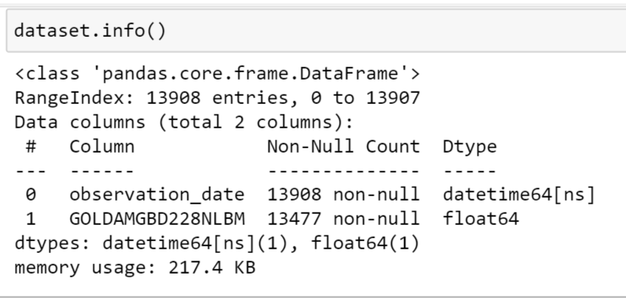
Data set summary

Slide 6
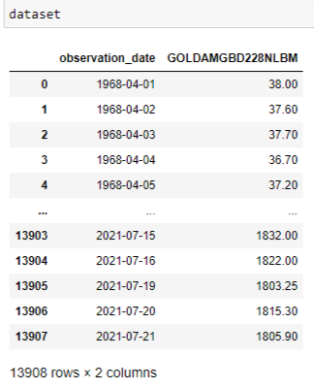
Outlook of the Dataset

Slide 7
INFERENCES FROM DATASET
There are 13908 entries in the Dataset.
➤ There are no Duplicated entries in the Dataset.
➤ There is one column with datetime datatype column and 1 float type column.
➤ There are 431 Null values in the Dataset which is supposed to be treated.

Slide 8
CORRELATION ANALYSIS

Slide 9
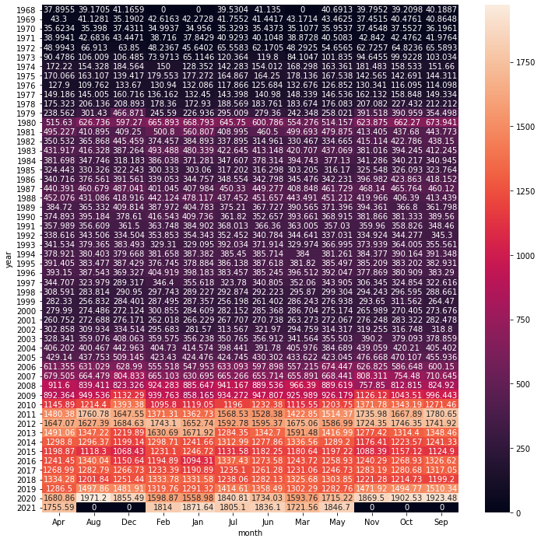

Slide 10
Exploratory Data Analysis

Slide 11
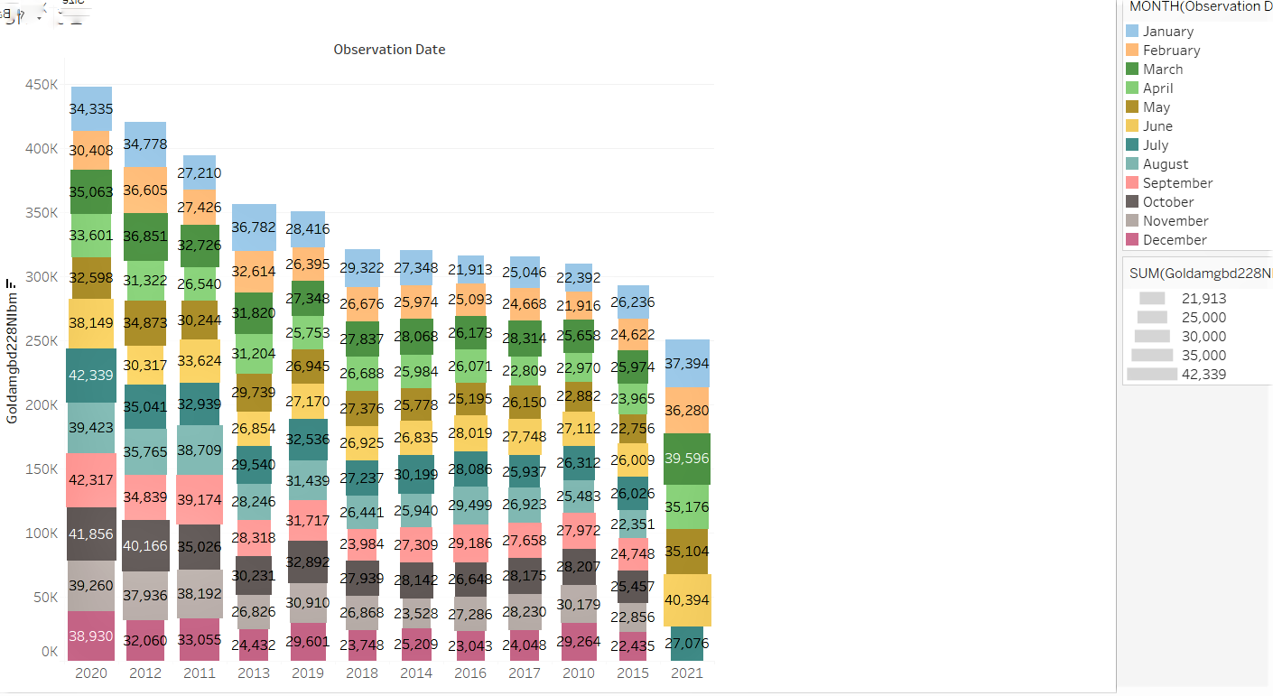
Gold price trend over the month
In 2020, in the month of august the sum of the rates are more .
In every year in the month of january ,the rates are low.

Slide 12
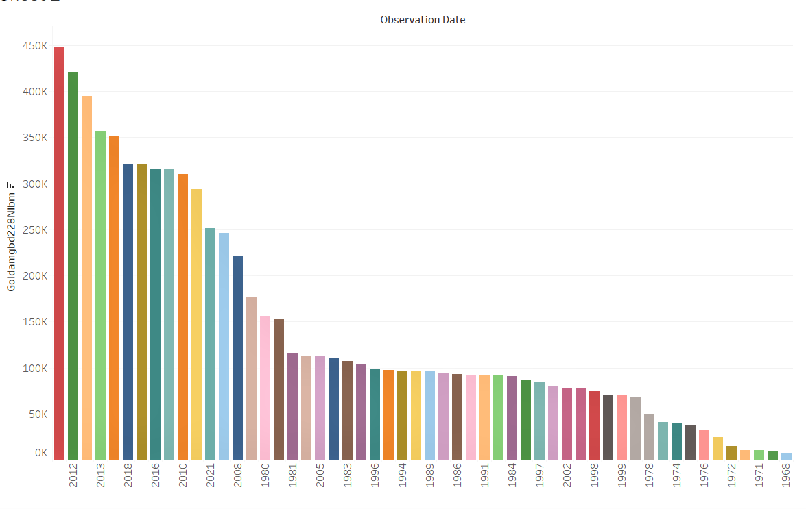
Gold price trend over the years
Rates are increasing gradually and it is more in 2012 and less in 1968 and from 1988 to 1999 the rate differs slightly

Slide 13
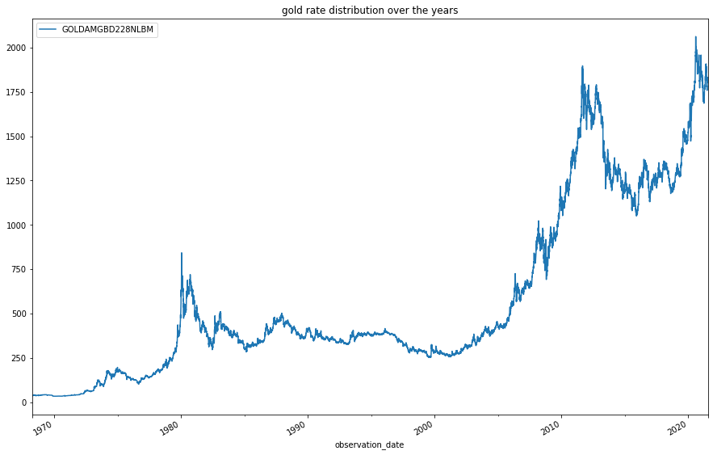
Gold price Trend

Slide 14
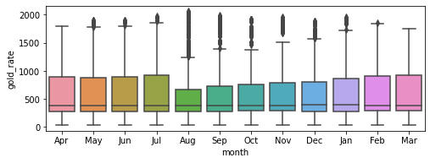
Box plot for detection of outliers

Slide 15
Seasonality

Slide 16
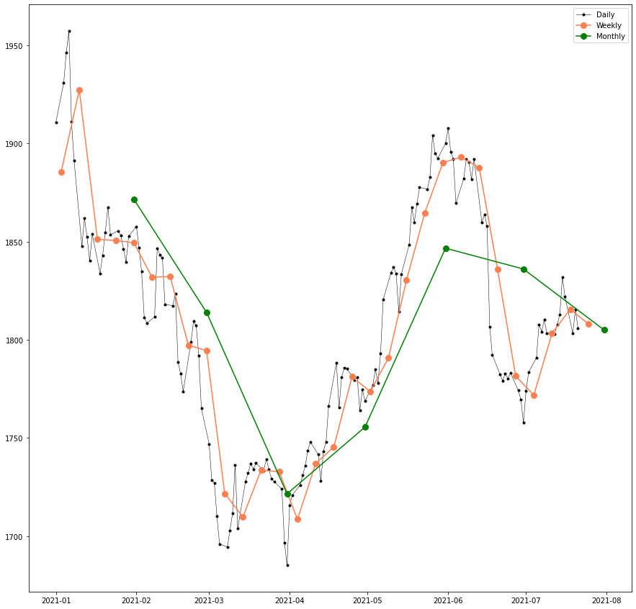
Monthly ,yearly ,weekly variation of gold price

Slide 17
Moving average

Slide 18
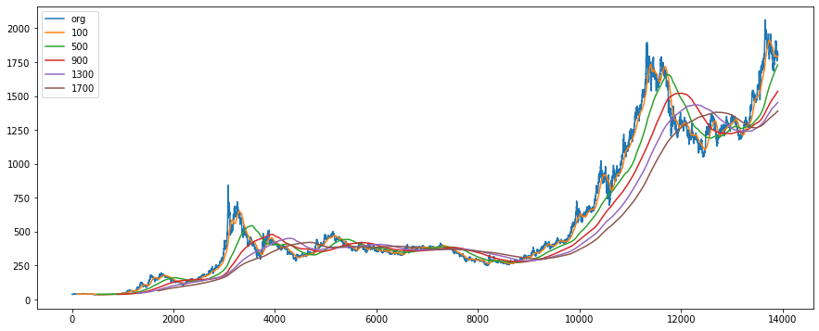
moving average with a range of 400 days

Slide 19
Residual ,trend, seasonality,observed

Slide 20
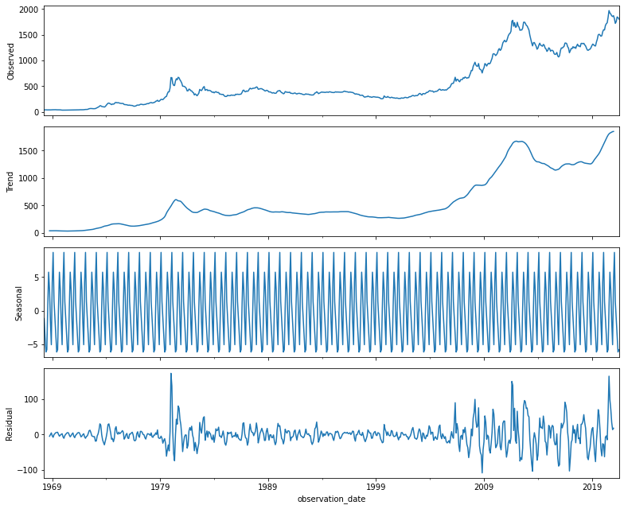

Slide 21
Stationary and differencing

Slide 22
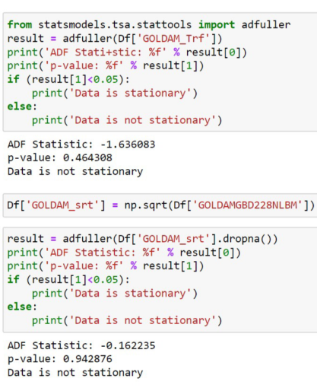
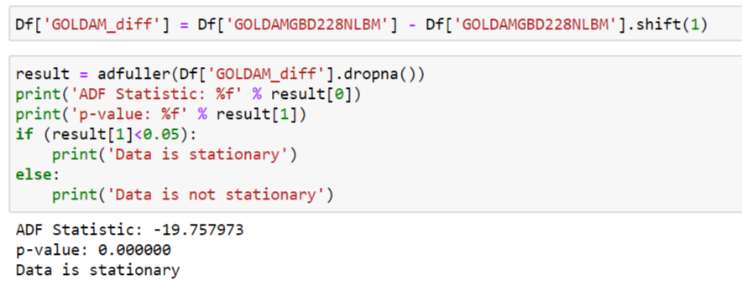
Applied Square root , log transformation
differencing with 1 shift

Slide 23
Model accuracy

Slide 24
Accuracy of the models
Linear regression train-92% test-90%
Arima train-65% test-60%
Sarimax train-72% test-70%
LSTM train-97% test-94%

Slide 25
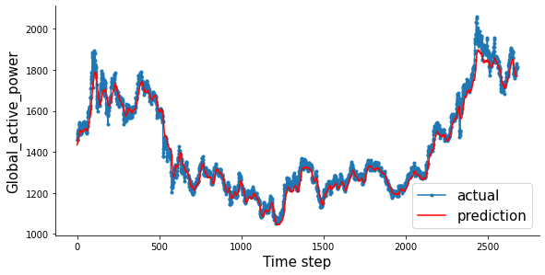
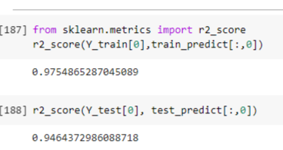
Difference between Actual and predicted trends

Slide 26
Predicted value of next 30 days

Slide 27
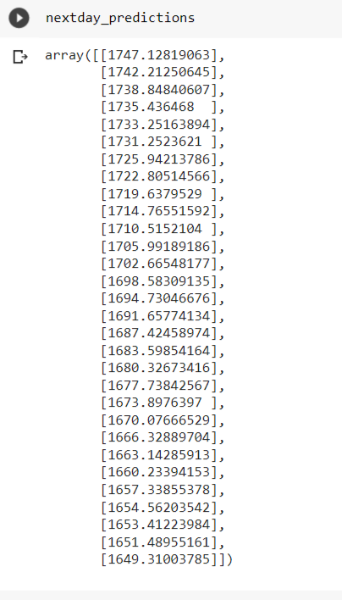
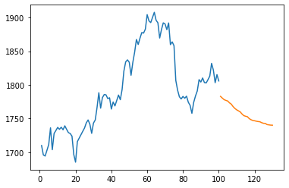
Predicted price of next 30 days

Slide 28
Deployment of model

Slide 29
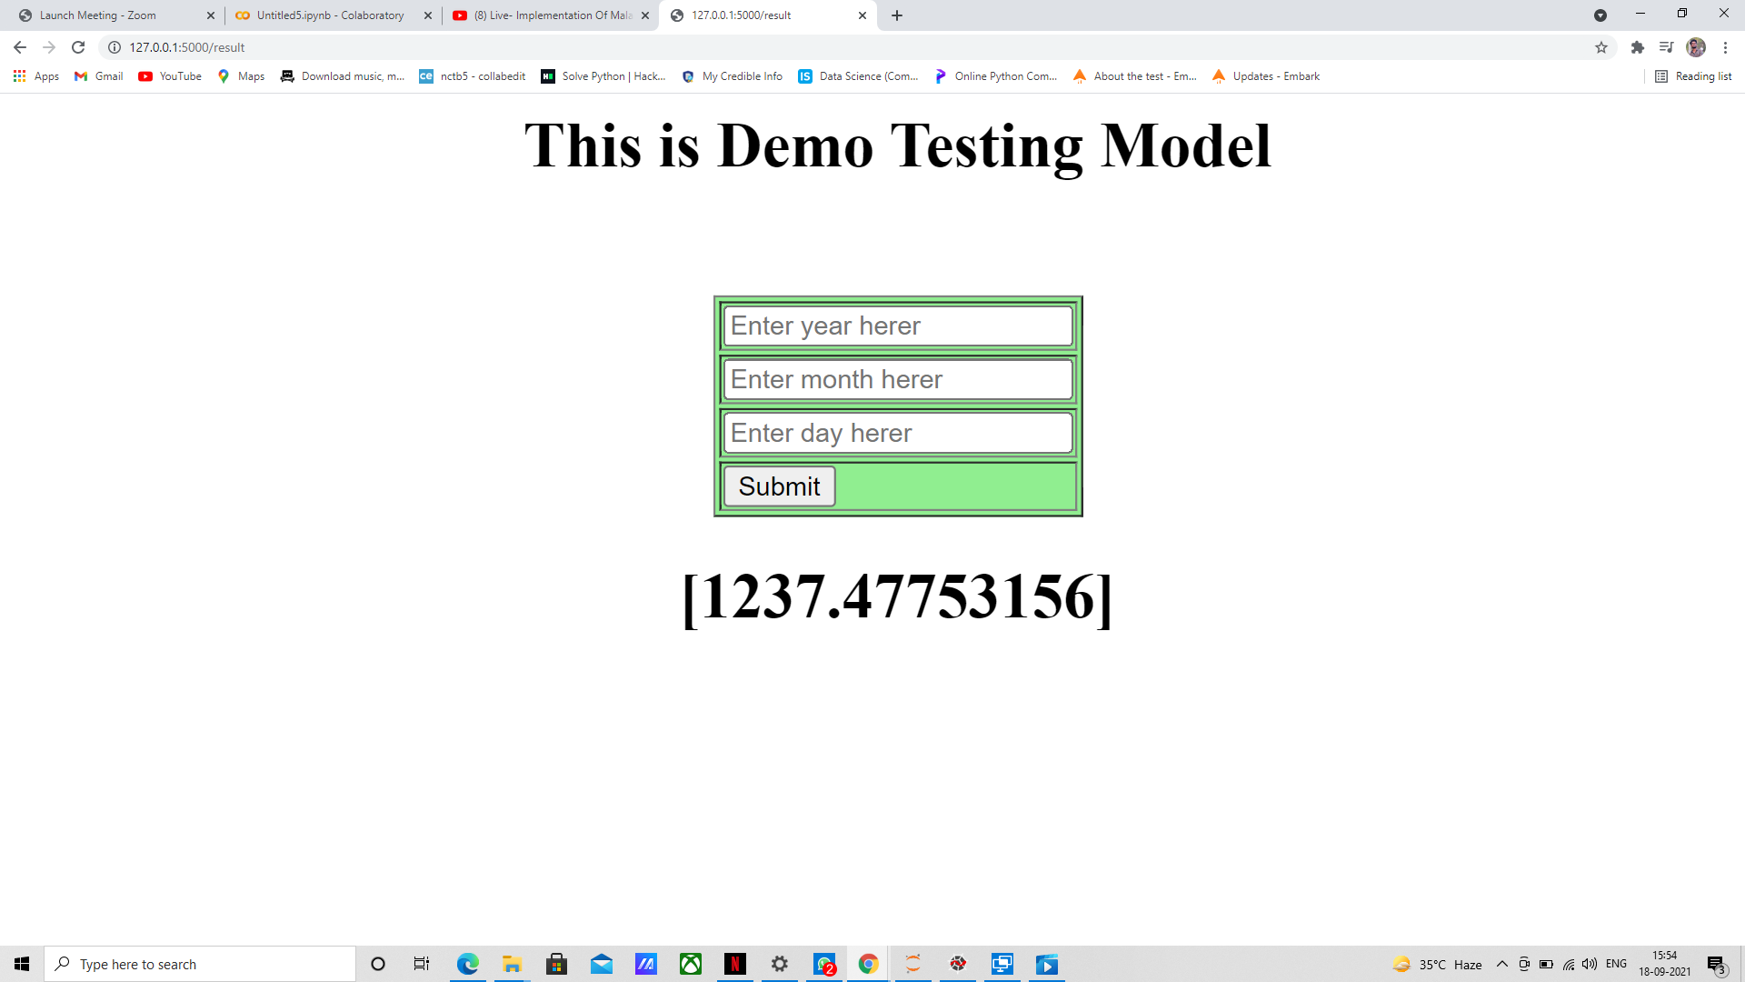
Deployment page of the model

Slide 30
Thanking you

